Slide 1
Wage Competitiveness in Levels
ECB, 12.4. 2018

Slide 2
Content
Equilibrium wages: theory
Descriptive evidence
Testing the performance of the WCI
Conclusion

Slide 3
I. Equilibrium wages: theory

Slide 4
The problem: ULC indices

Slide 5
The problem: ULC indices

Slide 6
The solution
A competitive economy with free flow of capital would tend to the equalization of rates of return on capital (RoC)
This is a benchmark
Distortions and monopoly power lead to sustained differences in RoC
Derive (benchmark) equilibrium wage at which the wage level would generate same RoC for each sector/region

Slide 7
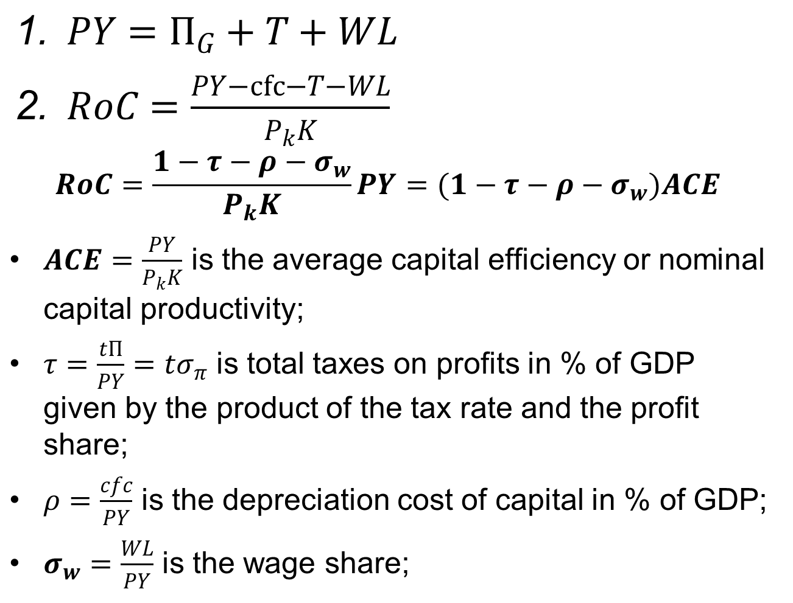
$PY=Π_{G}+T+WL$
$RoC=\frac{PY−cfc−T−WL}{P_{k}K}$
$$RoC=\frac{1−τ−ρ−σ_{w}}{P_{k}K}PY=(1−τ−ρ−σ_{w})ACE$$
$ACE=\frac{PY}{P_{k}K}$ is the average capital efficiency or nominal capital productivity;
$τ=\frac{tΠ}{PY}=tσ_{π}$ is total taxes on profits in % of GDP given by the product of the tax rate and the profit share;
$ρ=\frac{cfc}{PY}$ is the depreciation cost of capital in % of GDP;
$σ_{w}=\frac{WL}{PY}$ is the wage share;

Slide 8
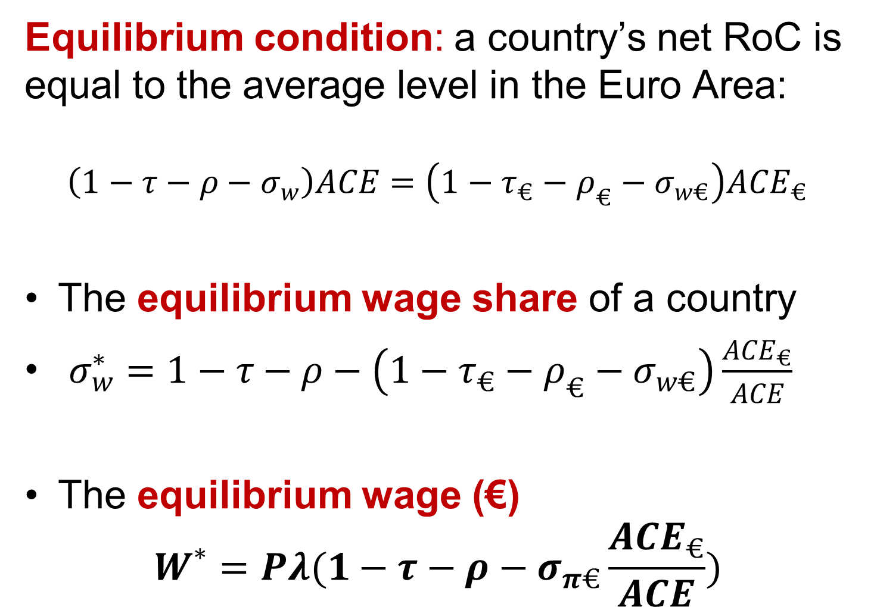
Equilibrium condition: a country’s net RoC is equal to the average level in the Euro Area:
$$\left(1−τ−ρ−σ_{w}\right)ACE=\left(1−τ_{€}−ρ_{€}−σ_{w€}\right){ACE}_{€}$$
The equilibrium wage share of a country
$σ_{w}^{∗}=1−τ−ρ−\left({1−τ}_{€}−ρ_{€}−σ_{w€}\right)\frac{{ACE}_{€}}{ACE}$
The equilibrium wage (€)
$$W^{∗}=Pλ(1−τ−ρ−σ_{π€}\frac{{ACE}_{€}}{ACE})$$

Slide 9
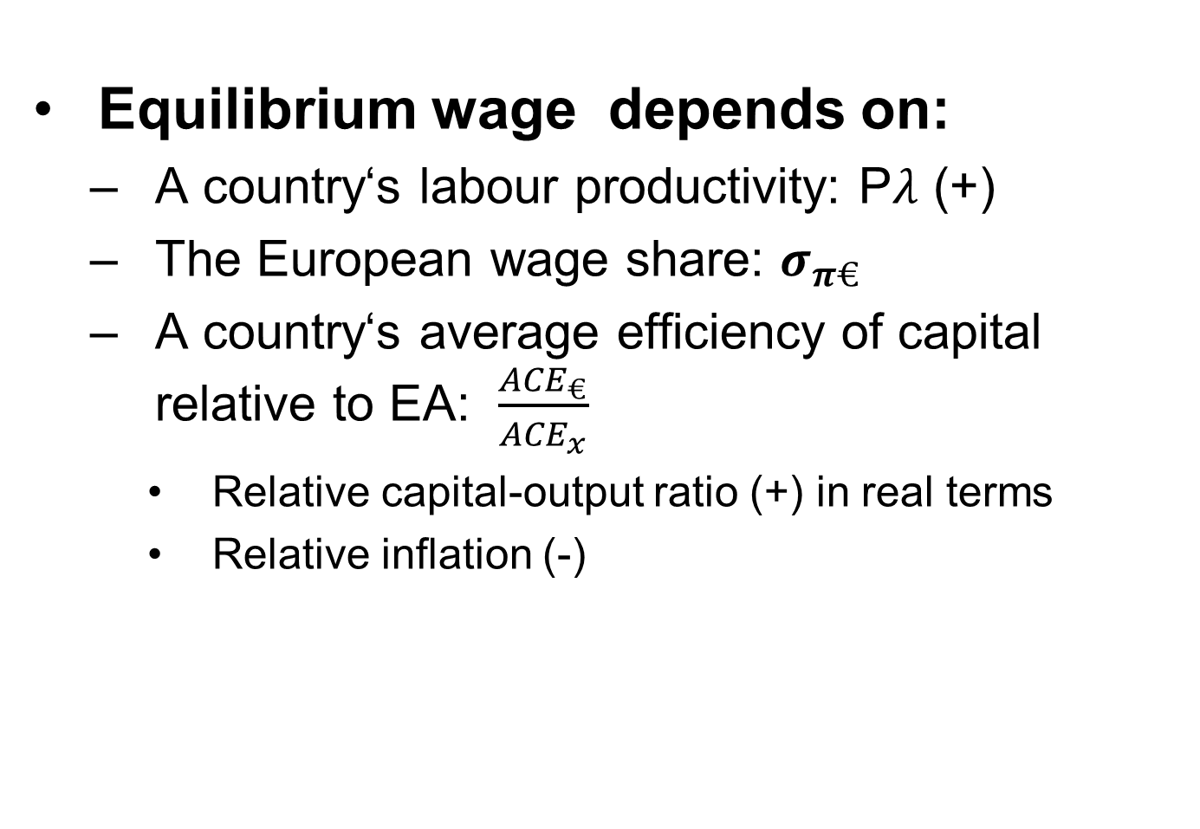
Equilibrium wage depends on:
A country‘s labour productivity: P$λ$ (+)
The European wage share: $σ_{π€}$
A country‘s average efficiency of capital relative to EA: $\frac{{ACE}_{€}}{{ACE}_{x}}$
Relative capital-output ratio (+) in real terms
Relative inflation (-)

Slide 10
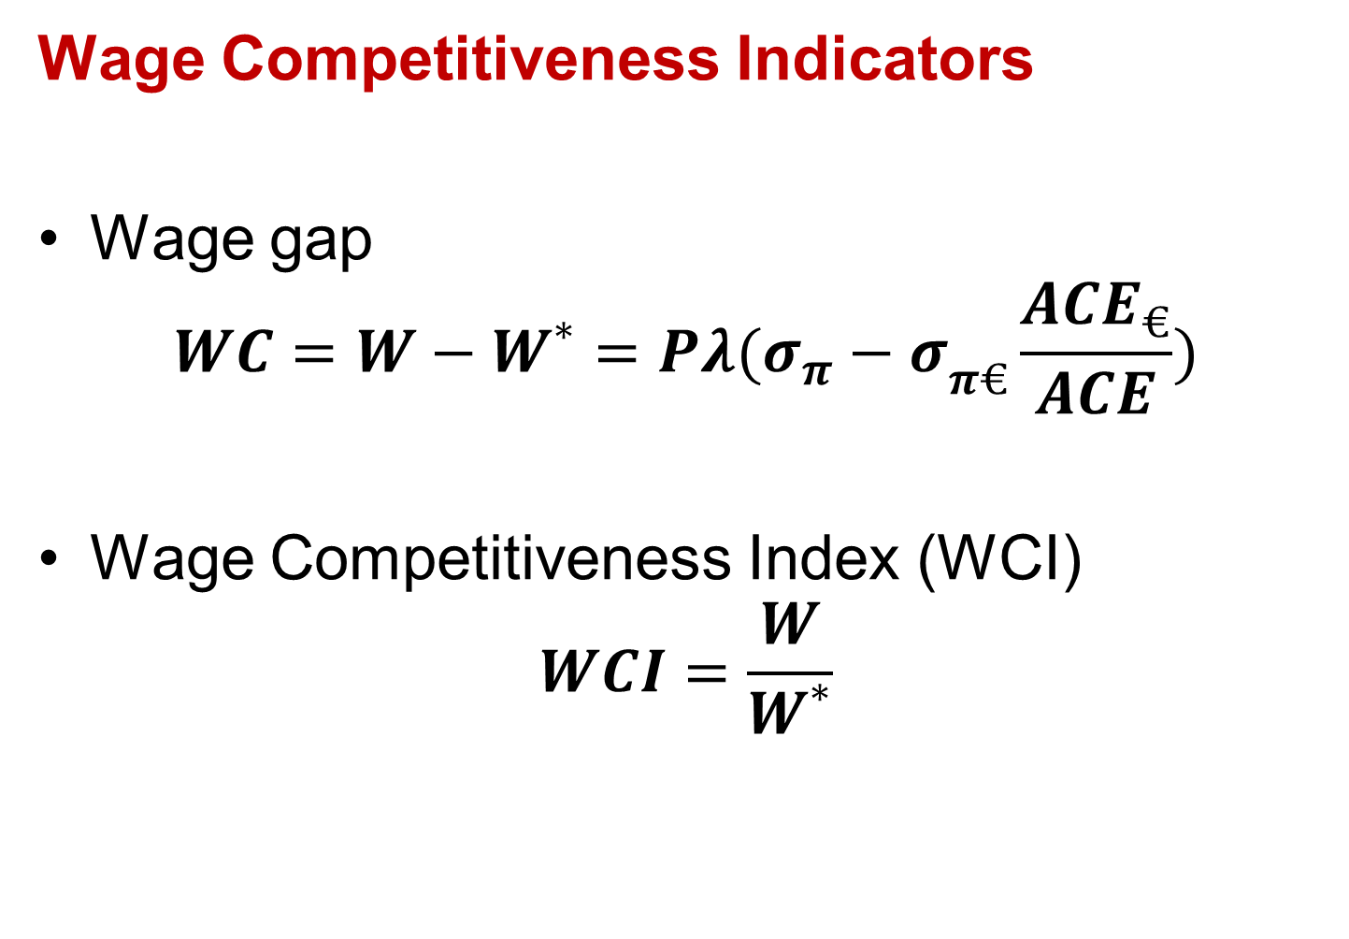
Wage Competitiveness Indicators
Wage gap
$$WC=W−W^{∗}=Pλ({σ_{π}−σ}_{π€}\frac{{ACE}_{€}}{ACE})$$
Wage Competitiveness Index (WCI)
$$WCI=\frac{W}{W^{∗}}$$

Slide 11
The wage gap depends on three variables:
nominal wages
labour
capital productivity (all relative to the Euro Area).
Excessive competitiveness can always be corrected by increasing wages
but lack of competitiveness does not necessarily imply cutting wages if productivity improves.

Slide 12
Higher capital productivity implies that the capital-output ratio in a given country or sector will be falling faster than in the Euro Area as a whole.
“extra” labour-augmenting technical change

Slide 13
II. Descriptive evidence

Slide 14
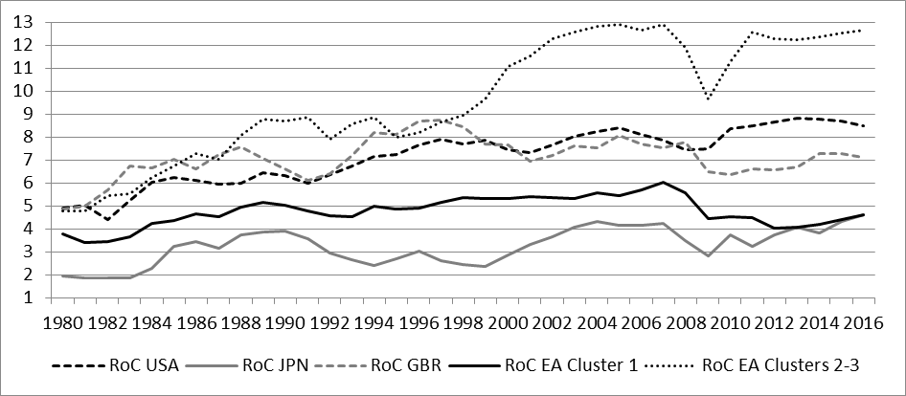
Return on Capital
Cluster 1: EA12; Cluster 2: Cyprus, Malta and Estonia Cluster: new MS

Slide 15
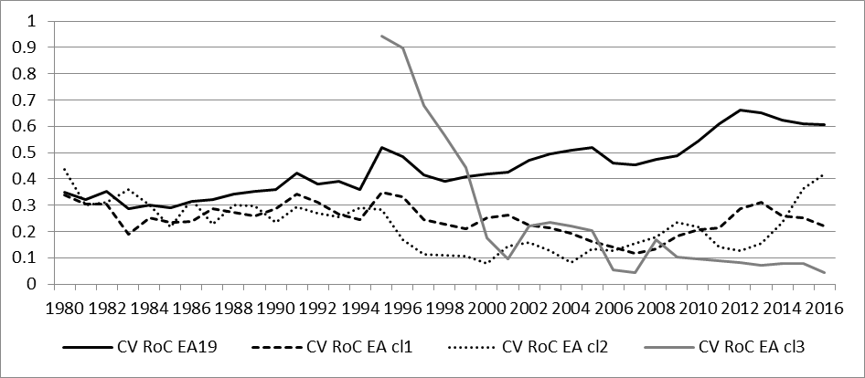
Return on Capital Convergence
Coefficient of variation
Cluster 1: EA12; Cluster 2: Cyprus, Malta and Estonia Cluster: new MS

Slide 17
Equilibrium wage against actual wage

Slide 18
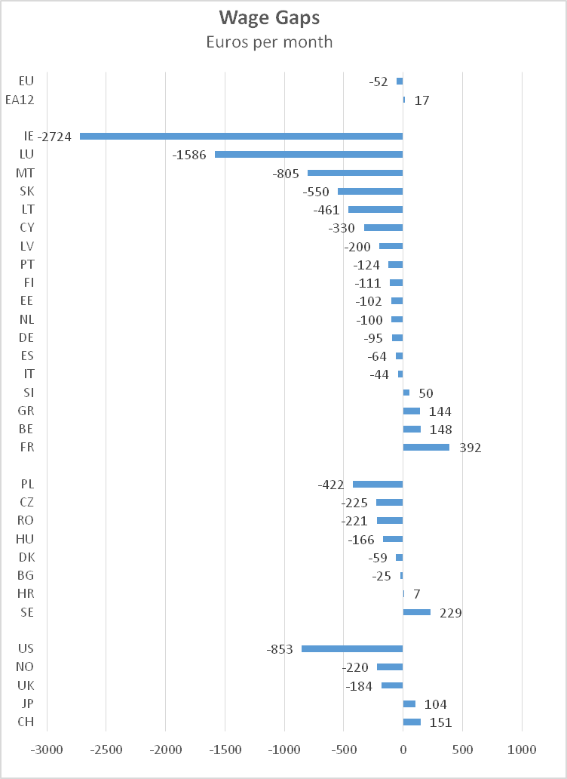

Slide 19
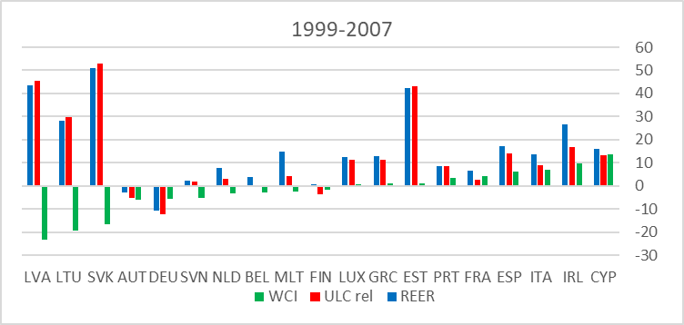
Figure 5 – Comparison between WCI, ULC and REER in the Euro Area:
percentage changes 1999-2007

Slide 20
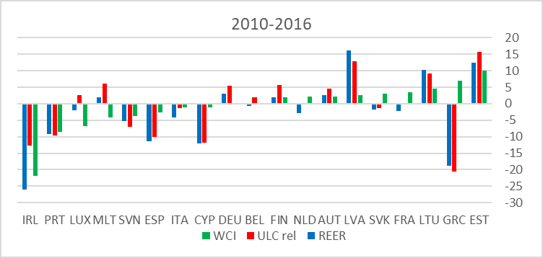
Figure 5 – Comparison between WCI, ULC and REER in the Euro Area:
percentage changes 2010-2015

Slide 21
III. Testing the performance of the WCI

Slide 22
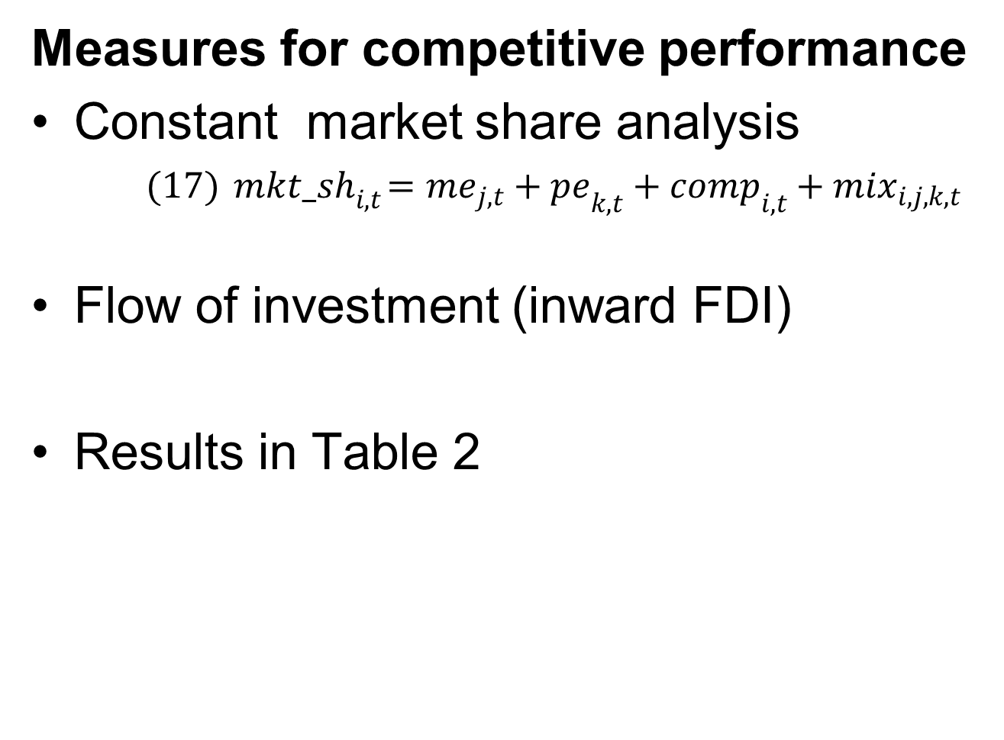
Measures for competitive performance
Constant market share analysis
$(17){ mkt_sh}_{i,t}={me}_{j,t}+{pe}_{k,t}+{comp}_{i,t}+{mix}_{i,j,k,t}$
Flow of investment (inward FDI)
Results in Table 2

Slide 23
Measures for competitive performance
The WCI is the only significant determinant in EU
both intra-EU and intra-EMU market shares (second and third panels)
whereas REER performs slightly better to explain total market shares in global trade (first panel)
WCI is based on equilibrium wages for the EMU, hence failing to capture the effect of developments outside the EU

Slide 24
Measures for competitive performance
For pure competitiveness effect: confirmation that the WCI has a higher explanatory power both within the EU and the EMU
For FDI inflows: the WCI is the only significant variable

Slide 25
IV. Conclusion

Slide 26
Wage setting obviously matters for competitiveness
but it is impossible without an appropriate benchmark to say whether wages are too high or too low.
benchmark for determining equilibrium wage levels is derived from the assumption that the return on capital in a given country (or industry) ought to be the same as the average return on capital in the Euro Area.

Slide 27
The famous Rehn-Meidner rule recommended that nominal wages ought to be distributionally neutral
Constant wage share
Δw = Δλ + Δp*
This rule ignores the impact of capital productivity on equilibrium wages.
Balanced growth across countries and sectors would require nominal wages to be equal to equilibrium wages.

Slide 28
Austerity policies seek lower wages
But cutting demand reduces output & lowers productivity of capital and labour which in return hampers competitiveness.
Greece is the most dramatic example
Competitiveness differences are not always correctly represented by ULCs and REERs
European Commission would be well advised to include the wage competitiveness index

Slide 29
Thank you !

