Slide 1

Professor Stefan Collignon
Public Finance for a Genuine Federal Democratic Union
An Introduction into Public Spending and Taxation Issues for Myanmar
Konrad Adenauer Foundation, Yangon
May 2018

Slide 2
Introduction
2015 NLD Election Manifesto stated that the new government will
strive for the establishment of a genuine federal democratic union based on the principles of freedom, equal rights and self-determination”
enable the effective use of the public financial system and the full and systematic collection of financial revenues,
establish a public financial management system that is transparent, ensures prudent expenditure, and is in line with financial standards.
In order to reduce centralized financial control, the authority and responsibility for financial matters will be divided appropriately between the Union and the State/Regional governments.

Slide 3
General Principles
Economic development is driven by markets. We distinguish between
private goods, which are exchanged in markets, and
public goods, which are supplied and consumed collectively.
roads, electricity, schools, etc.,
Public goods, are necessary for markets to operate effectively.
They contribute to the economic efficiency and the general well-being
provision of public goods to citizens is the purpose of government

Slide 4
General Principles
Taxes finance the provision of public goods
“There is no free lunch”
Time must be spent, resources must be bought, and skills are needed to produce public goods.
Unfortunately, markets cannot produce public goods efficiently
the morality of taxpayers depends on their “willingness to pay
that depends on the legitimacy of the government, which must respond to the collective preferences for public goods.

Slide 5
General Principles
Three functions of public finance
Allocation function
Efficient use of resources
Stabilisation function for macroeconomic stability
Price stability and economic growth
Distribution function
Fairness and social harmony
Poverty

Slide 6
General Principles
Allocation of public funds to purchase public goods

Slide 7
General Principles
Macroeconomic instability

Slide 8
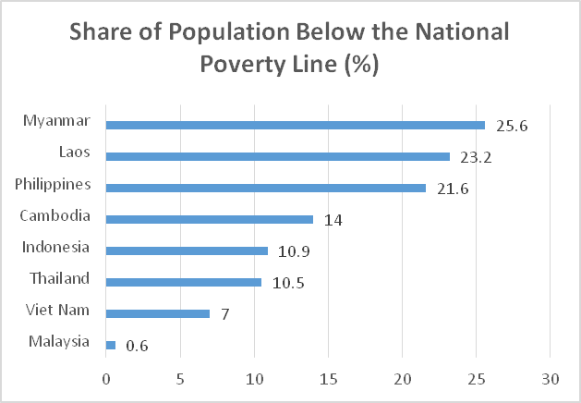
General Principles

Slide 9
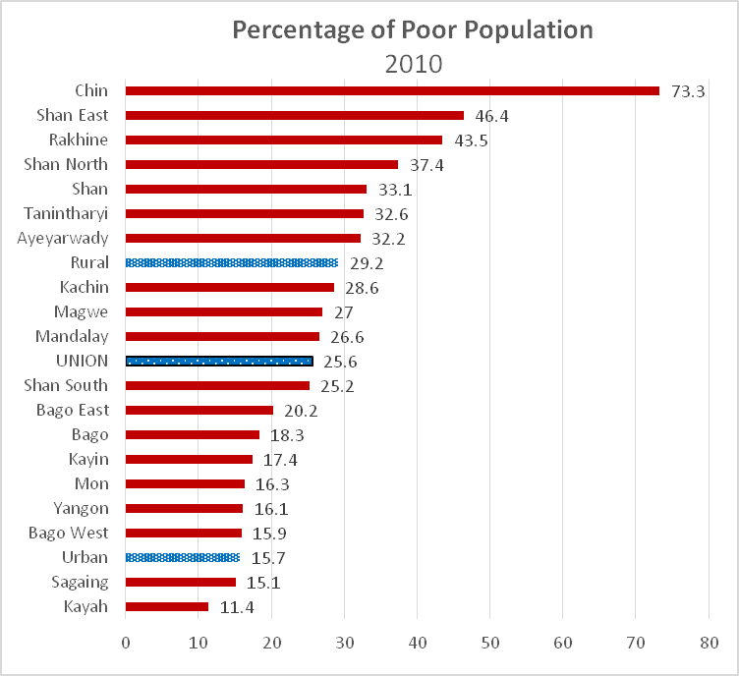
General Principles

Slide 10
Public finance
When the government’s revenue is insufficient to cover the expenditure, it has a deficit and must go into debt.
There is nothing wrong in borrowing money to finance public goods or stabilize the economy in the short run.
what matters is that the deficit remains manageable and public debt remains sustainable.
This means that the debt level has to be compatible with economic stability.
The key is how the debt is managed.

Slide 11
Public finance
There are three possible sources for public borrowing:
savings from domestic households,
savings from foreign lenders,
Govt. issues Treasury bonds or Treasury bills
The government could also obtain grants from foreign donors.
Overseas Development Aid was in the order of 1-2 percent of gross national income; it jumped up to 6.7 percent in 2013, but has since fallen back to 2 percent.
the Central Bank.

Slide 12
Public finance
Monetary financing of the budget deficit.
the central bank buys govt bonds or issues money directly to the government.
This is called the monetization of public deficits
It is the main cause for Myanmar’s high inflation

Slide 13
Public finance

Slide 14
Public finance
The distorted banking system
In Myanmar, banks area major vehicle for governments to close the financing gap
Banks serve as the main intermediary by which savings are channelled to investors or governments.
State-owned banks provide loans to State-owned Economic Enterprises and thereby finance the budget indirectly.

Slide 15
Public finance
The distorted banking system
The four state-owned banks still account for nearly half of the banking sectors assets, with their lending largely targeting the state sector and large firms.
As a consequence, a large share, 49% in 2015/16, is lent to the government, with 80 % coming from the Central Bank of Myanmar and the remainder mainly from the state-owned banks.
This has created important distortions between the urban and rural economy and large and small enterprises.

Slide 16
Federalism
Federalism is a mechanism to make democracies more robust.
Political federalism recognizes that the preferences for some public goods are dependent on cultural and geographic factors
they change only slowly and conflict with the beliefs and preferences of the other groups.

Slide 17
Fiscal Federalism
Fiscal federalism organizes the economic side of federalism.
The principles of fiscal federalism respond to the question
who should pay for public goods?
in principle everyone who can enjoy their benefits.
National public goods must be funded from the central government’s budget
Local public goods ought to be paid for by revenue raised by local governments and administrations.

Slide 18
Federalism
Models of Federalism
The United States of America and the Federal Republic of Germany represent two opposite forms of federalism.
The US model is vertical federalism, because the competences are hierarchically ordered in accordance with the reach of public goods
Citizens separately elect representatives for the Federal, State and municipal governments, each of which has clearly distinct responsibilities

Slide 19
Federalism

Slide 20
Federalism
in Germany the federation is more integrated.
The whole state of Germany (Gesamtstaat) represents the nation and consists of the federal government and the local States (Länder).
Tax revenue is shared between levels of government
Länderfinanzausgleich = Redistribution to create equal living conditions

Slide 21
Federalism

Slide 22
Federalism
The 2007 Myanmar constitution defines federalism in Schedules I, II and V
It established the framework for administration and representation at one subnational level
the 14 States and Regions (plus the Union territory of Nay Pyi Taw)
Also mention of smaller subnational groupings
However, the actual responsibilities for using and mobilizing resources at the different government levels remain unclear

Slide 23
Federalism
In Myanmar the States and Regions are essentially part of the Union Government,
the districts are the organs to implement the Union Government’s decisions.

Slide 24
Federalism

Slide 25
Fiscal Federalism
When the separation is not clear, we need transfers and grants
In Myanmar, the Union Government
controls 88% of all public expenditure,
transferring only 12% to States and Regions.
This compares with
60% centralized expenditure in Germany and
50% in the United States.

Slide 26
Taxation
Sources of public finances: taxation and other revenues
Taxes are imposed on the productive capacities of the people and the products of the earth
natural raw materials, precious stones, and agricultural output.
Taxing people in kind or in money.
In Myanmar, the government
receives profits from owning State-owned Economic Enterprises (SEE)
gets revenue from selling or leasing access rights to natural resources.
can borrow in financial markets.

Slide 27
Taxation
A “good tax structure
The distribution of the tax burden should be equitable so that everyone pays a fair share
Taxes should minimize interference with economic decisions in otherwise efficient markets. If possible, market inefficiencies should be corrected by taxes
The tax structure should facilitate the fiscal policy stabilisation function and support long run growth.
The administration of the tax system should be efficient, non-arbitrary, transparent, and understandable by all taxpayers.
The administration and compliance costs should be as low as possible without hampering efficiency and distorting incentives for the private sector.

Slide 28
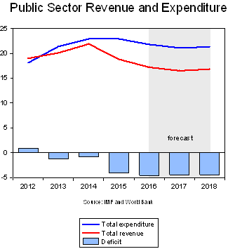
Taxation

Slide 29
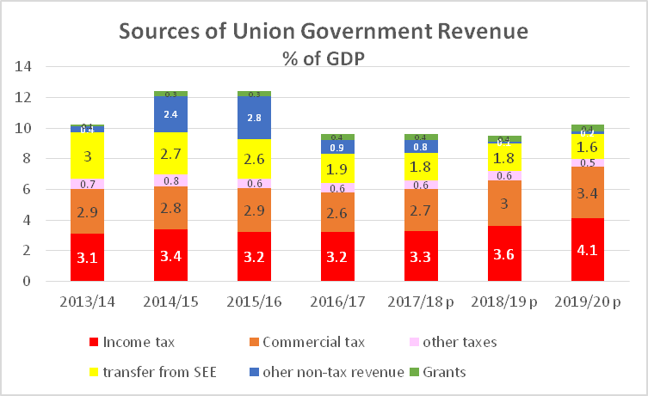
Taxation

Slide 30
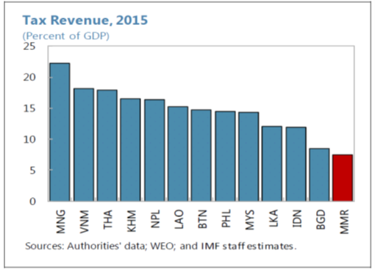
Taxation

Slide 31
Expenditure
In Myanmar, 6 out 22 ministries account for more than 80 percent of total ministry spending:

Slide 32
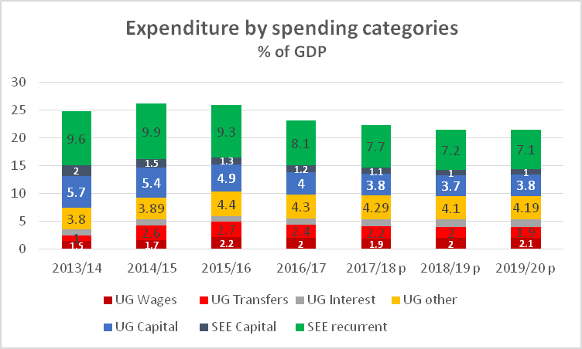
Expenditure

Slide 33
Taxation

Slide 34
Decentralization
State and Region Expenditure
The provision of public goods in Myanmar is primarily the task of the Union Government.
They are partially deconcentrated down to the district and township level.
State/Region responsibilities are mostly confined to localized, small-scale services.
For example, in the agricultural sector, the Union Ministry of Agriculture is generally in charge of “Dams, embankments and irrigation works managed by the Union”, while State /Region governments are responsible for “Dams, embankments and irrigation works having the right to be managed by the region or state”. Many provisions are of this nature in the Constitution, which opens the door for arbitrary management arrangements, uncertainty and inefficiencies

Slide 35
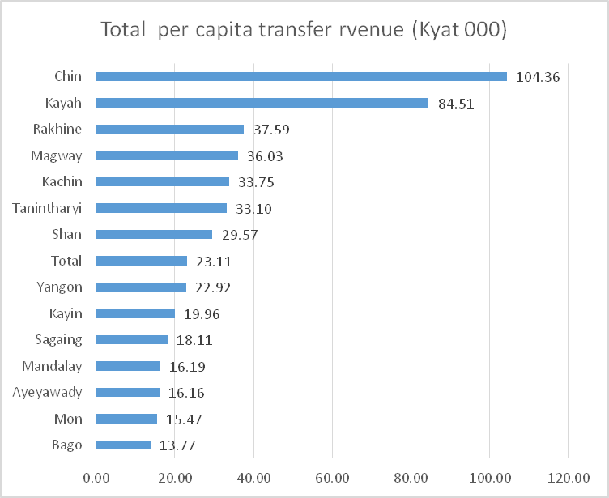
Decentralization
State and Regions accounted for 7.4 percent of total public sector expenditure in 2013/14, which compare with an average of 25 percent across other countries.

Slide 36
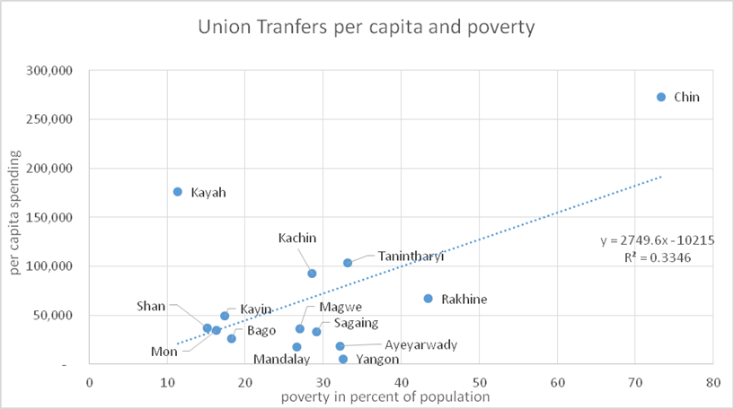
Decentralization

Slide 37
Decentralization

Slide 38
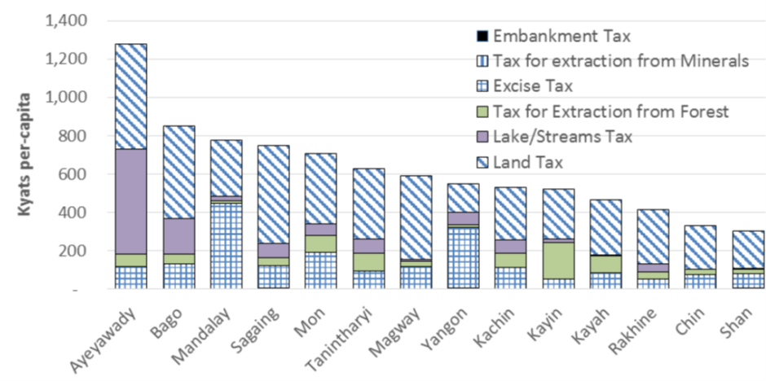
Decentralization

Slide 39
From War to Market
Transition from a War Economy to a Genuine Market economy
So far, we have looked at the structure of the state in Myanmar, based on the 2008 Constitution and its application. We must now look at the bigger picture, which includes the transition from a permanent war economy to a peaceful modern market economy
Many EAOs play an active role in providing services to local populations,
including: health, education, infrastructure, security, justice, forestry management and/or agricultural support.

Slide 40
From War to Market
In some locations EAOs have sole control of governance, but often they play a governance role in ‘mixed-authority’ areas alongside the Burmese government, Tatmadaw, other EAO(s), militias, and/or Border Guard Forces (BGFs).
In some locations, the governance actors operating in mixed authority areas have positive relations and some sort of agreement on their respective responsibilities, while in other areas they are in conflict with one another
The fact that EAOs are providing public services has certainly avoided the decent into social chaos and human disasters

Slide 41
Conclusion
Perspectives for a genuine federal democratic Union
For a genuine federal democratic Union, the competences between Union, State and Regions, and District levels must be redefined,
so that local preferences can be articulated and implemented more efficiently, without generating negative externalities
This reform requires more than just rebalancing Schedule I and II of the constitution.
Subnational institutions must have a greater degree of autonomy
citizens must be able to monitor and influence their governance. This implies, among other things, that Chief Ministers are elected by State and Region Parliaments and not appointed by the Union Government.

Slide 42
Conclusion
Perspectives for a genuine federal democratic Union
Ethnic Armed Organisations as well as parts of the Tamadaw are effectively states within the state.
Both must be integrated into the future Union of Myanmar under civilian control.
Merging the ethnic armed forces with the Tamadaw would generate substantial savings, provided the supreme command is under democratic control.
One way to integrate EAOs is to set up multilevel police and security forces as in most federal countries
the federal police is responsible for the implementation of national laws and regulations, while States and Regions dispose over local police forces to sustain law and order in accordance with local requirements.

Slide 43
Conclusion
Perspectives for a genuine federal democratic Union
Cultural diversity ought to be respected, and this must be reflected in the autonomy of educational and religious institutions.
At the level of secondary (high schools) and tertiary education (Universities), common standards must be set that are coherent with the quality requirements of international scientific skills.
While local tax setting powers increase the autonomy of subnational authorities, the inequality of income and poverty between different states requires a revenue sharing mechanism that must be rule-based and not subject to political discretions.
Transfers from the Union to the subnational units must follow clear and transparent rules and not be subject to political discretion.

Slide 44
Conclusion
Perspectives for a genuine federal democratic Union
Public debt ought to remain under the exclusive authority of the Union Government.
However, State and Union Governments ought to be represented in a federal policy-making council of the Myanmar Central Bank (MCB).
In order to facilitate local economic development, Regional and State Development Banks or cooperative savings associations should be set up
Sharing sales taxes (VAT) and personal income tax at fixed proportions is the most efficient way to finance public goods.

Slide 45
Conclusion
Perspectives for a genuine federal democratic Union
Tax rates for very high incomes and capital gains ought to be increased in order to generate higher income and satisfy norms of equity and social justice.
There is no danger that rich Myanmar citizens would leave the country for tax reasons, if rates were higher. However, the transfers of capital abroad ought to be regulated.
State-owned Economic Enterprises ought to be decentralised with respect to services that benefit local communities.

Slide 46
Conclusion
These principles reflect the norms of a genuine federal democratic union anywhere in the world.
They are necessary to accelerate economic development as well as peace, stability and harmony in a future democratic Union of Myanmar.

Slide 47
Conclusion
Thank you !

